Slide 1



Snow Water Equivalent vs. Stream Discharge Comparison
Sarah Ruth Merrigan,
Dr. Xubin Zeng, University of Arizona Department of Hydrology and Atmospheric Science
ASU/NASA Space Grant Symposium
April 22, 2017

Slide 2
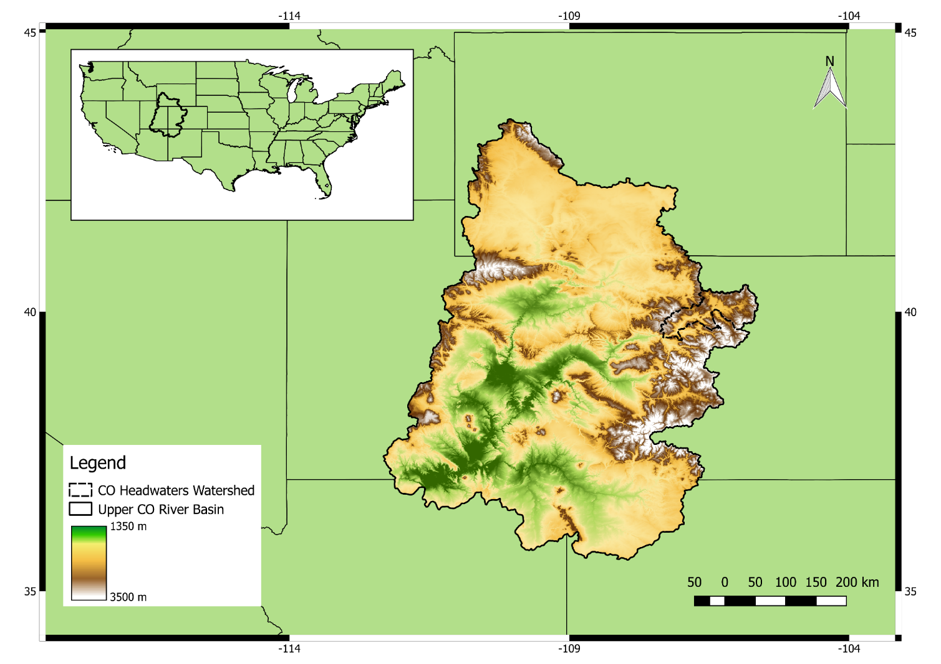
Problem Statement
Snow is the main source of water in the Upper Colorado River Basin
By finding a correlation between snow water equivalent (SWE) and river discharge, a model can be developed to predict flow based on the amount of snow
Upper Colorado River Basin

Slide 3
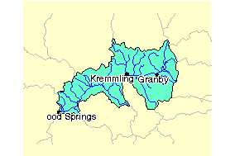
Overview
The project focused on the Colorado Headwaters Watershed
A small watershed within the Upper Colorado River Basin
Flow data was collected at the gauge of discharge for the watershed
The gauge with the lowest elevation
Station Number 9070500: Colorado River Near Dostero, CO
Elevation of 6,130 feet
Colorado Headwaters Watershed
(EPA)

Slide 4
Methods
Snow data was analyzed using MATLAB
Abstract SWE data from geo referenced files (.tiff files)
Organize data into graphs to compare to flow discharge
The lag between peak snow water equivalent and peak discharge for each year was identified
Discharge values were obtained from the Colorado Water Science Center
Full 30 years of data had to be requested from the Water Science Center
Data was organized in MATLAB and compared to snow data

Slide 5
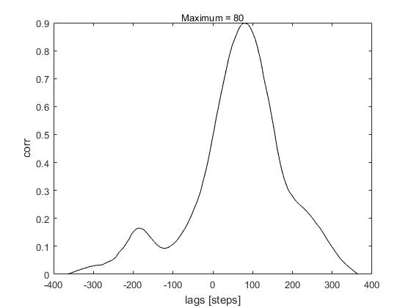
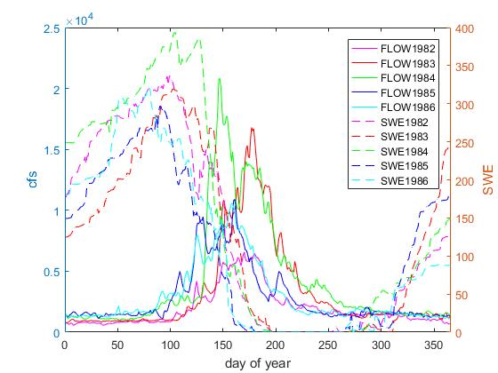
Results
SWE vs Discharge for years 1982-1986
Lag plot for year 1986 (lag of 80 days)

Slide 6
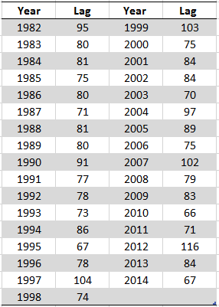

Results
Statistical Analysis for all lag values for years 1982-2014

Slide 7
Application
The significant correlation between snow water equivalent and discharge can be used to develop a numerical model
This model can be used to predict the amount of available water for a year based on snowfall and precipitation
This model would assist the agriculture industry, allowing for a better understanding of available water resources

Slide 8
Acknowledgements
Dr. Xubin Zeng
Nick Dawson
UofA Department of Hydrology and Atmospheric Sciences
NASA Space Grant

Slide 9
Thank you

Slide 10
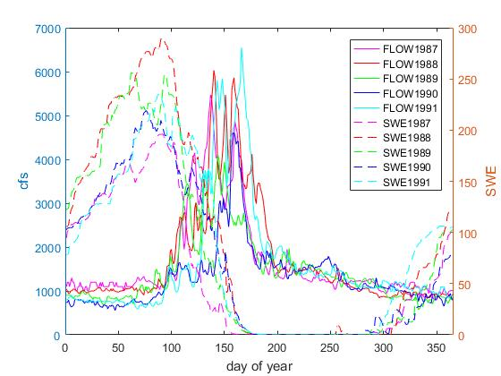
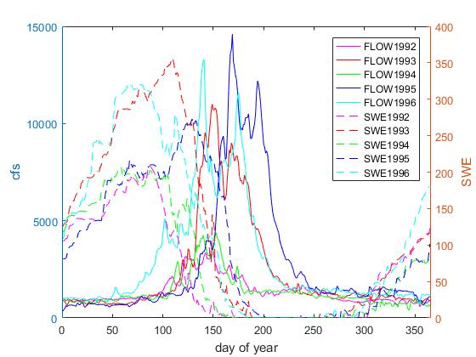
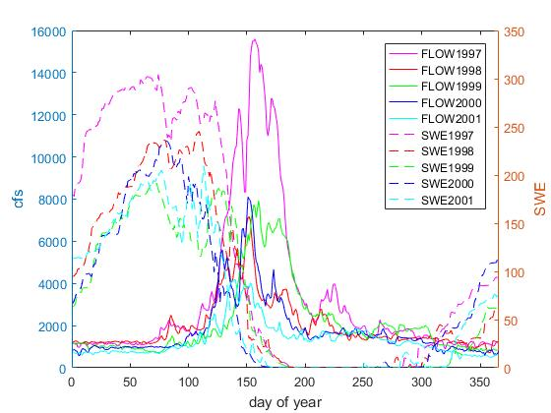
SWE vs Discharge 1982-1986
SWE vs Discharge 1987-1991
SWE vs Discharge 1992-1996
SWE vs Discharge 1997-2001

Slide 11
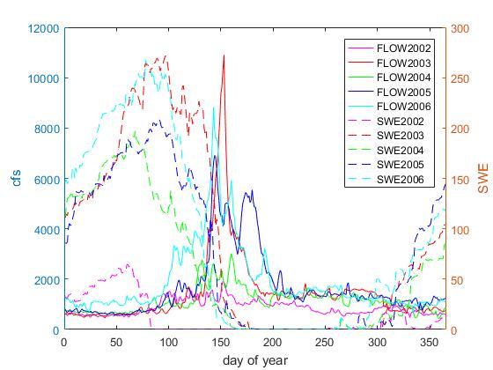
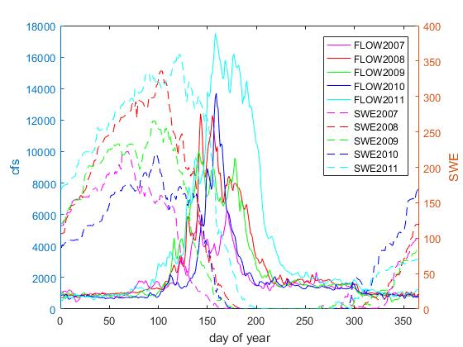
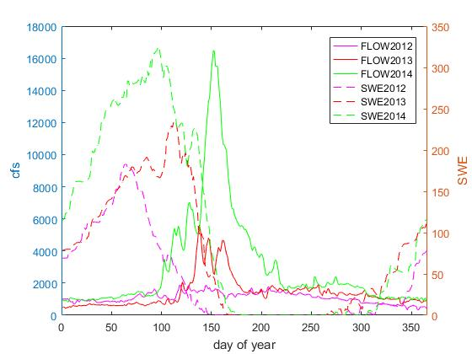
SWE vs Discharge 2002-2006
SWE vs Discharge 2007-2011
SWE vs Discharge 2012-2014

